Slide 1
Syllabus IHE Groundwater Flow
Transient Analytical Solutions
Prof.dr.ir.T.N.Olsthoorn, 2019-2020

Slide 2
Transient groundwater flow:
Only if some form of storage is available
Without storage pressures would spread at (almost) infinite speed, --- the flow system would be steady
Every physical system shows at least initially some dynamics in storing energy, momentum or mass

Slide 3
Groundwater systems
Some groundwater systems react fast, an equilibrium is reached in days to weeks.
Some systems react extremely slowly; it may take hundreds or even thousands of years before an equilibrium is finally reached
For example: Kalahari, > 10000 years
Small parcel between ditches, 2 days

Slide 4
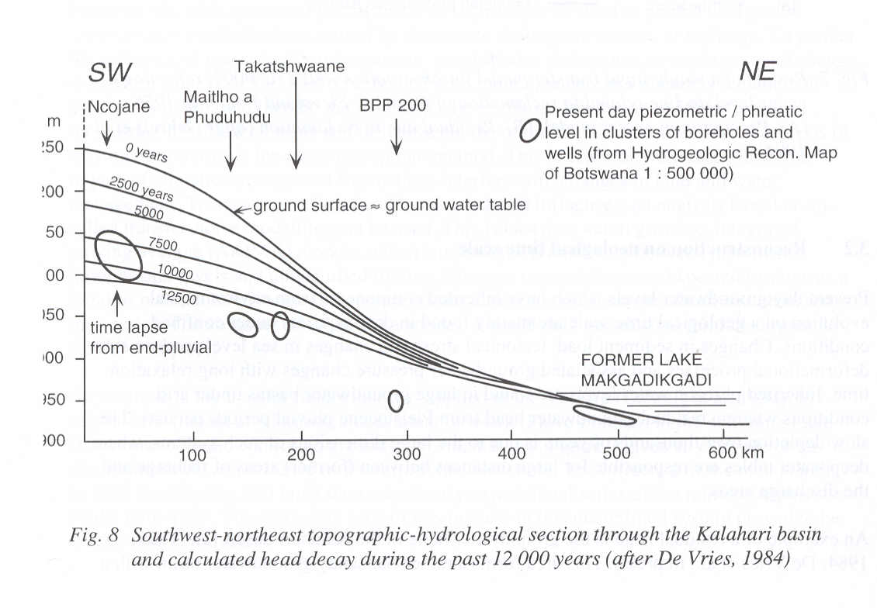

Slide 5
Forms of subsurface water storage
Irreversible storage
Liquefaction
Subsidence (consolidation)
Over-extraction of fresh water causing intrusion and upconing of saltwater in an aquifer (almost irreversible, i.e. may take centuries to restore).
Reversible storage
Water table storage
Elastic storage

Slide 6
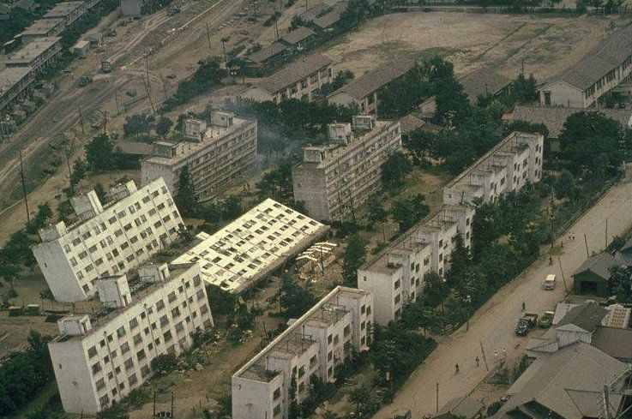

Slide 7
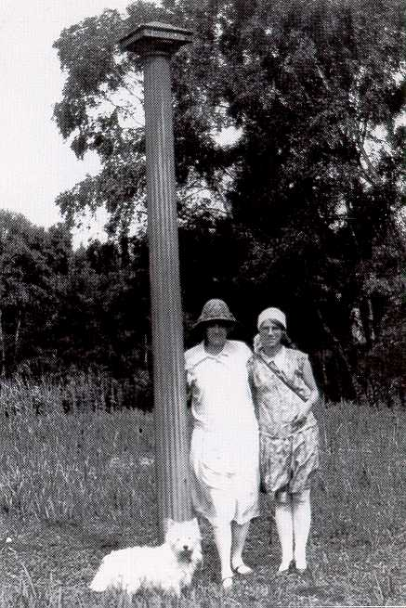

Slide 8
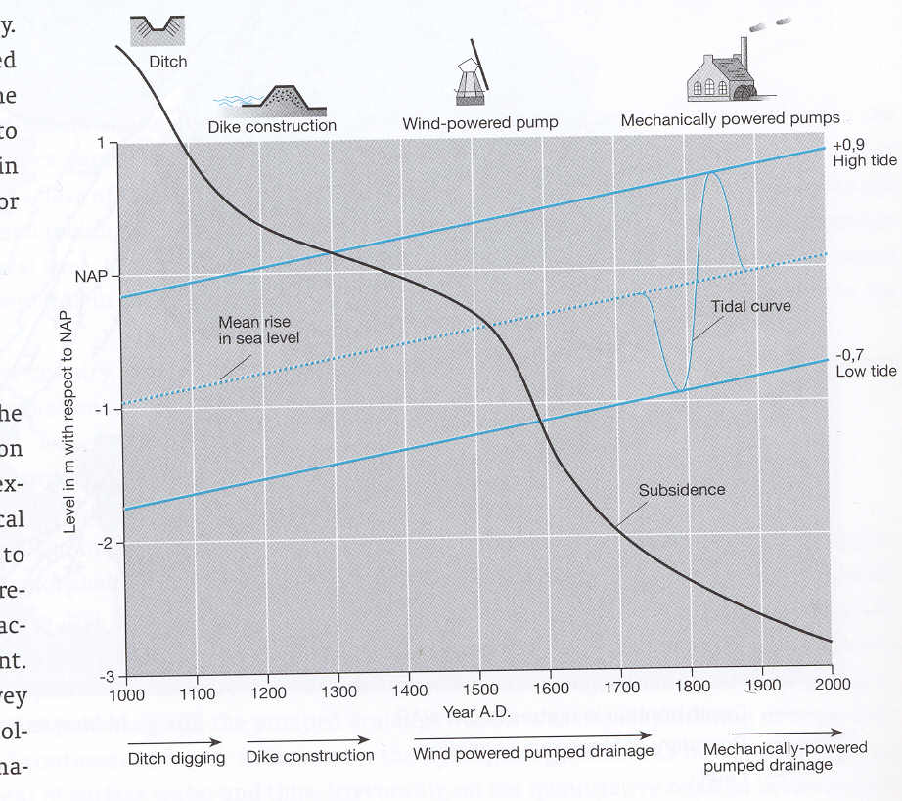

Slide 9
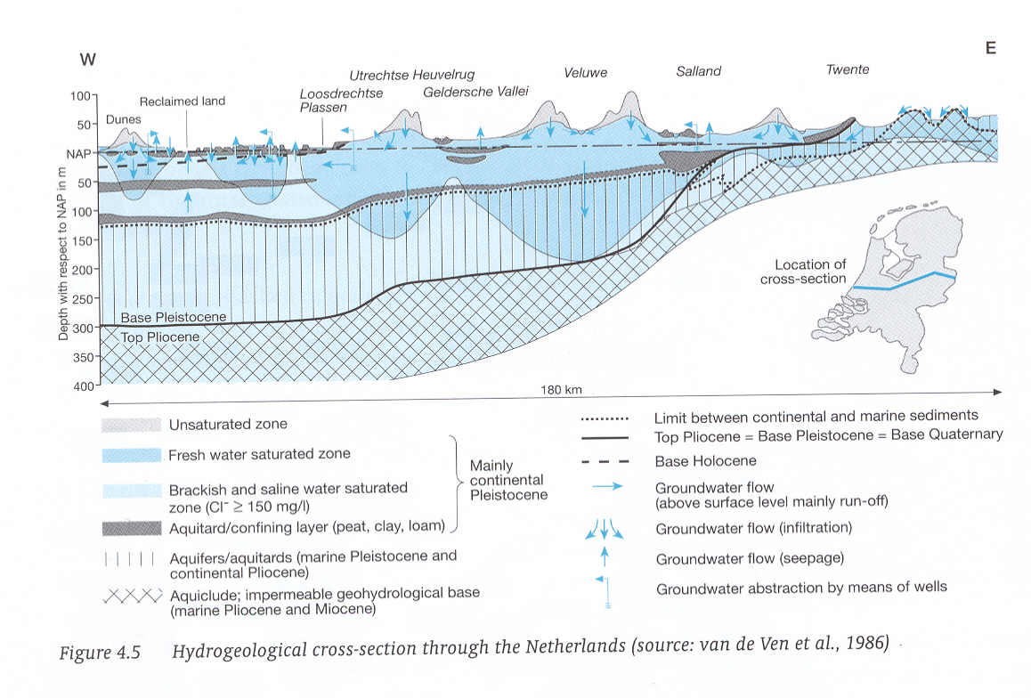

Slide 10
Variations in storage of water in aquifers are possible because
Elastic behavior of water, grains and especially the porous matrix as a whole
Storage of water above the water table in the unsaturated zone (emptying and filling of pores)
Sometimes: compression of gas, e.g. in petroleum engineering or when gas is formed in the subsurface e.g. by biochemical reactions (CH4)

Slide 11
Forms of storage

Slide 12
Phreatic or water-table storage
Keywords:
Unsaturated zone
pF-curves
Specific yield

Slide 13
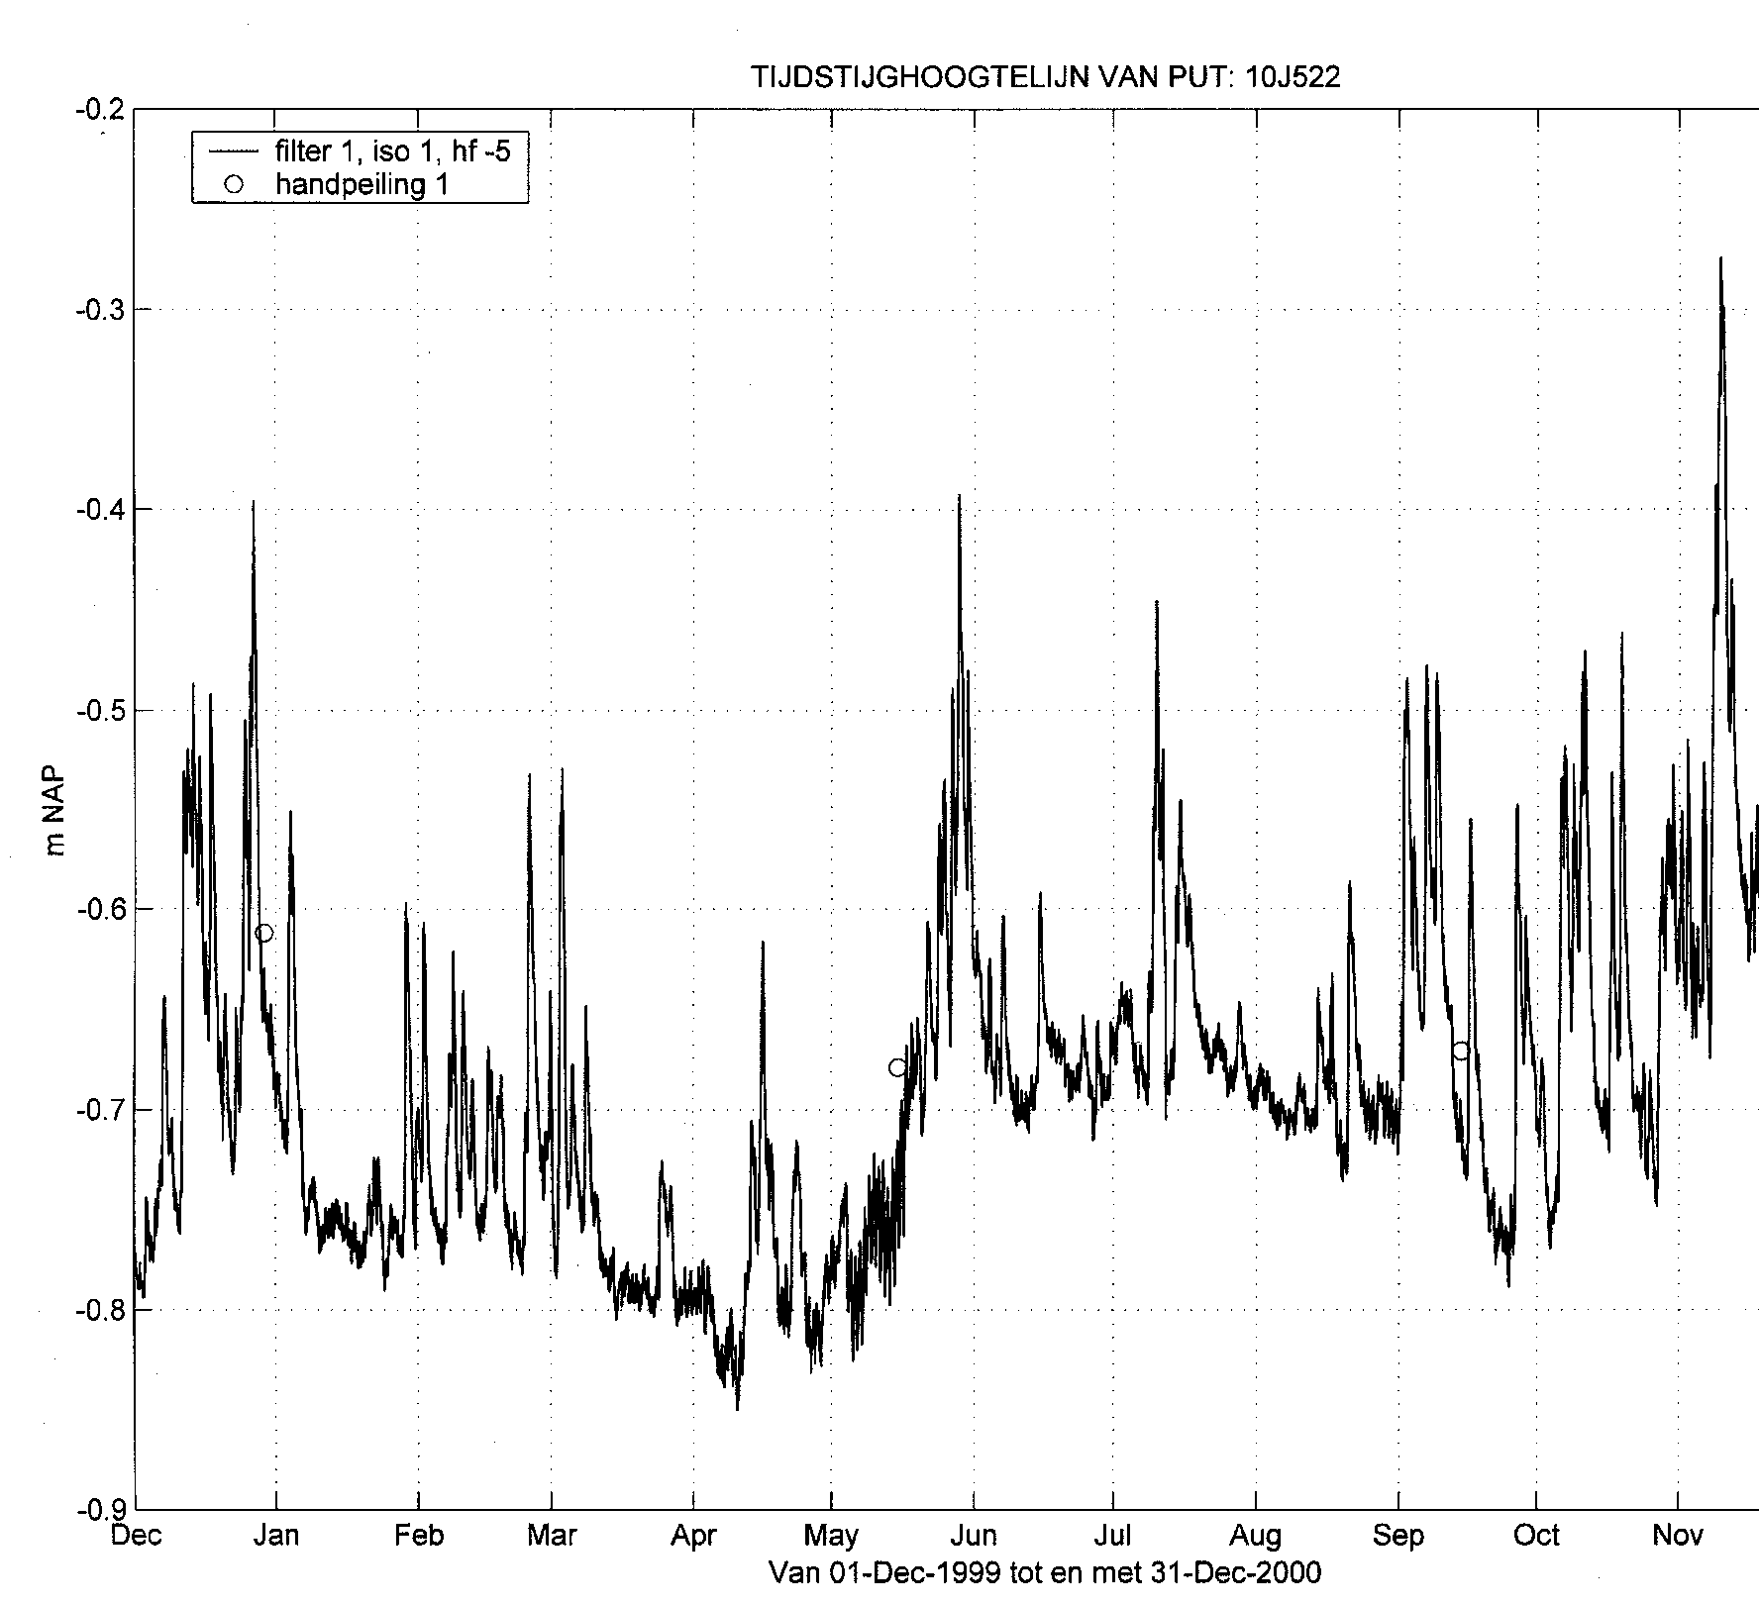
Example of fluctuations of the water table measured in an
Observation well in the dune area south of Zandvoort, The
Netherlands
Line: hourly registration
Circles: hand measurements for verification

Slide 14
Capillarity (as the simplest model of the unsaturated zone)
α
r
R
Meniscus
=
sphere
(
must
be
)
compare
with
half
sphere
h
p
=
−
ρ
gz
c
z

Slide 15
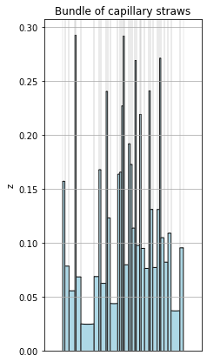
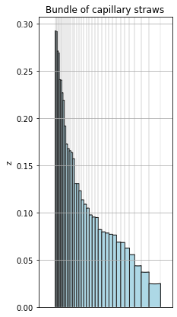
The unsaturated zone may be viewed as a set of tubes (straws) with a
distribution of widths. Capillary rise depends on tube width.

Slide 16
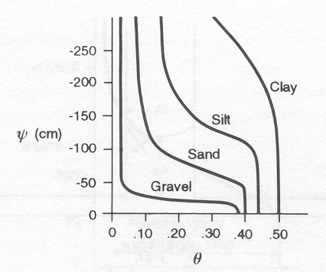
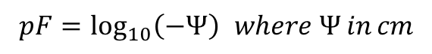
Saturation or pF curves for different materials
$$pF=\log_{10}\left(−Ψ\right) where Ψ in cm$$

Slide 17
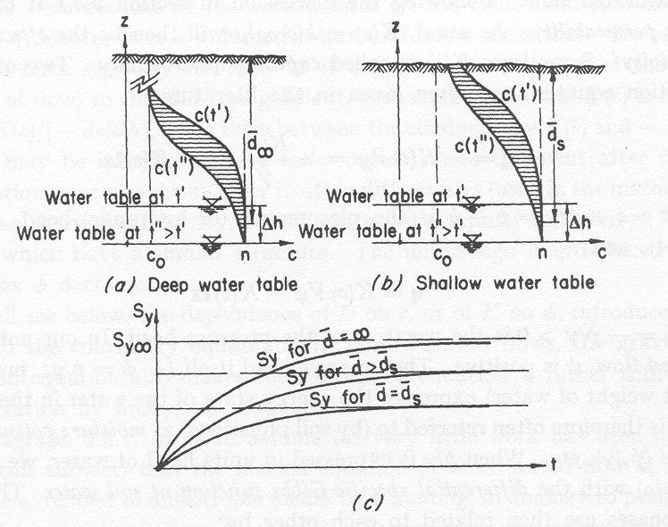
Drainage from the unsaturated zone, deep vs shallow water table
Cut-off moisture
profile
Actually drained

Slide 18
Free gravity drainage leaves some water behind → specific yield

Slide 19
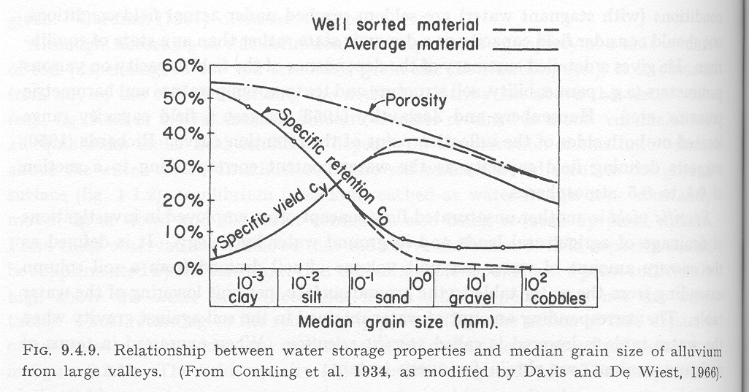
Specific yield vs specific retention. (Porosity tends to be smaller for coarser materials)

Slide 20
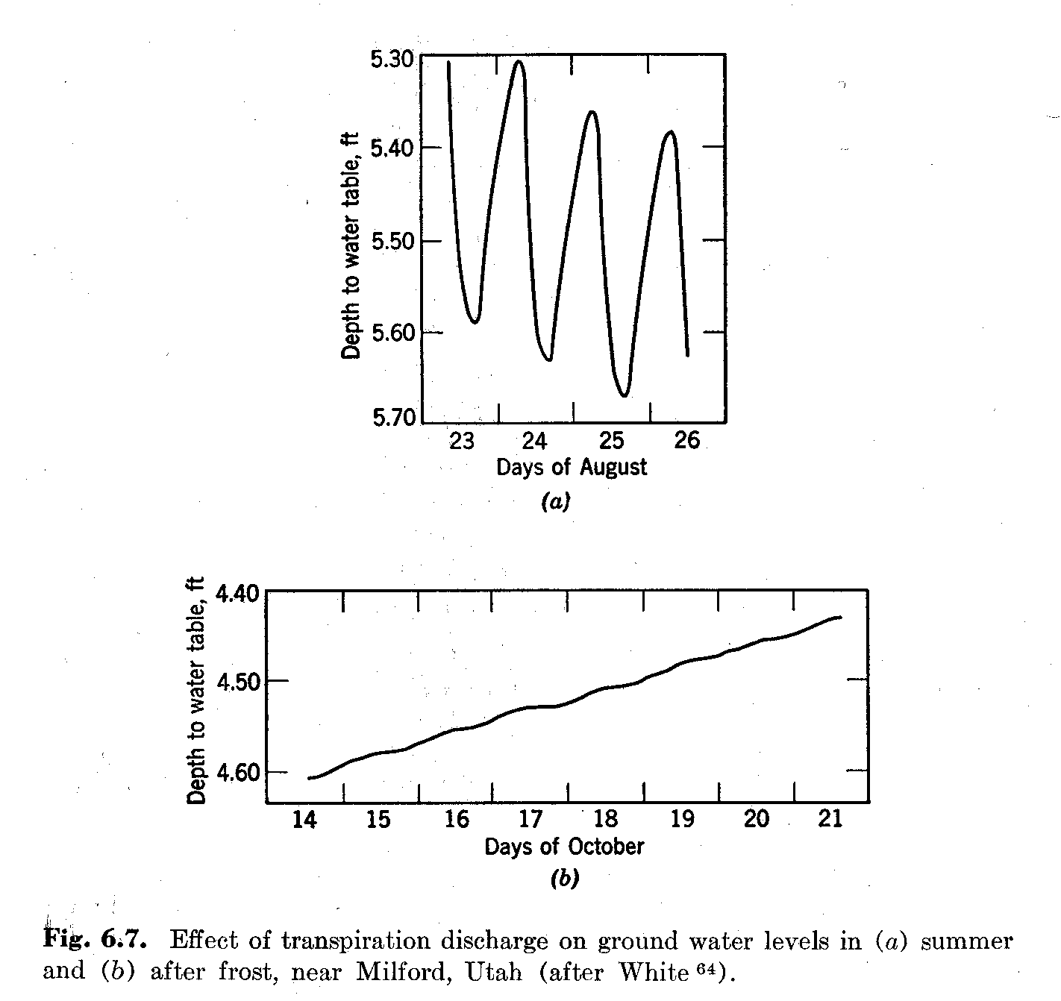
Effect of daily plant transpiration on shallow water table.

Slide 21
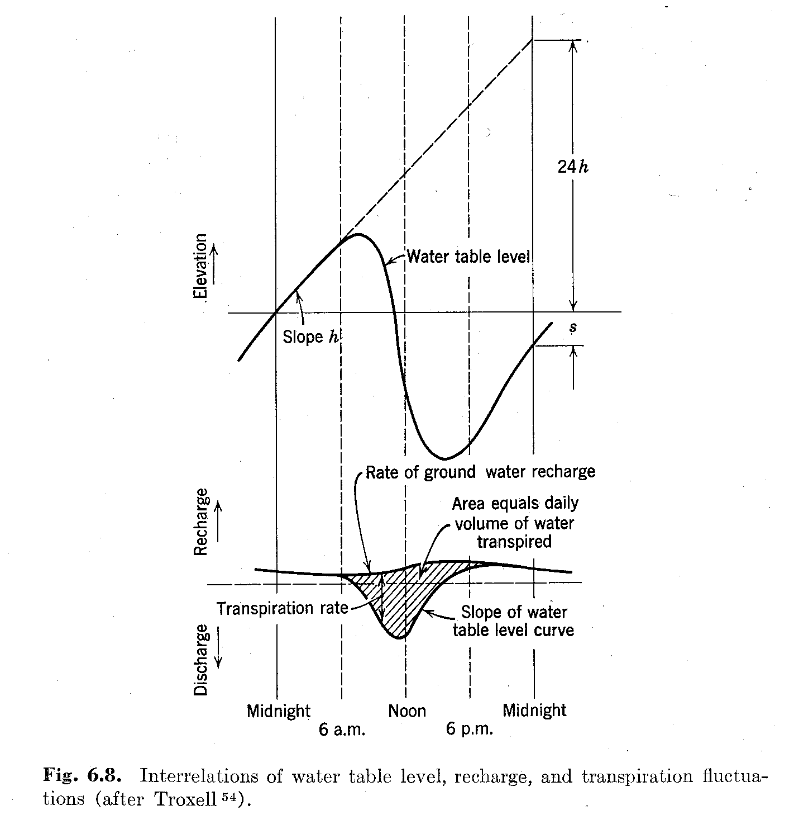
Estimation of transpiration from daily water-table fluctuation
Water table
decline in
24 hours
Trend (no transpiration during the night)
Rate of groundwater
recharge
Water table
decline in
24 hours

Slide 23
Elastic storage (semi)-confined aquifers
Keywords:
Specific (elastic) storage S_{s}
Elastic storage of aquifer S
Barometric efficiency
Loading efficiency
(Earth tide)

Slide 24
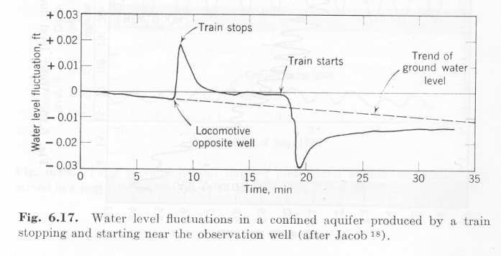
First –ever registered confined groundwater head fluctuation under varying load (i.e. a train) at ground surface

Slide 25
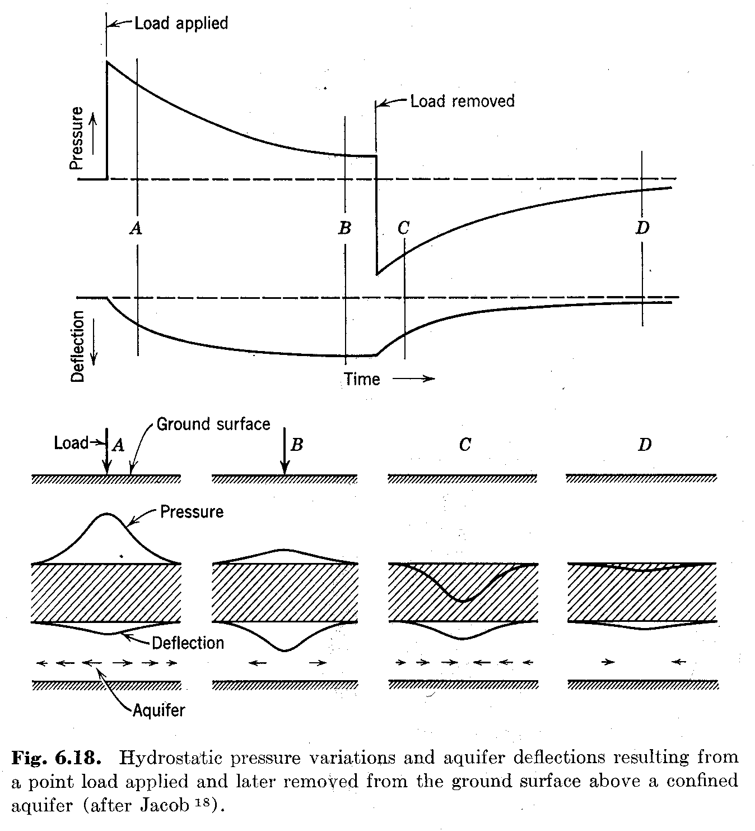
Explanation of the ”train effect”, i.e. of the effect of a varying load at ground surface on the head in a (semi)-confined aquifer.

Slide 26
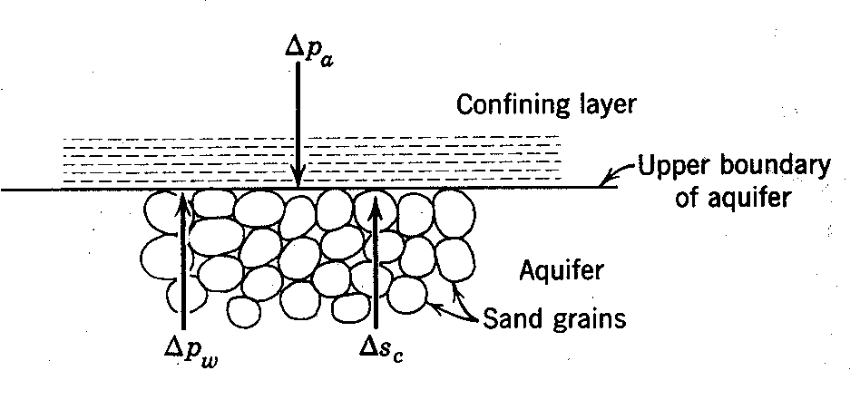
Alternative way of explaining the same thing, focusing on the changes of the water pressure and that at the porous matrix.

Slide 27
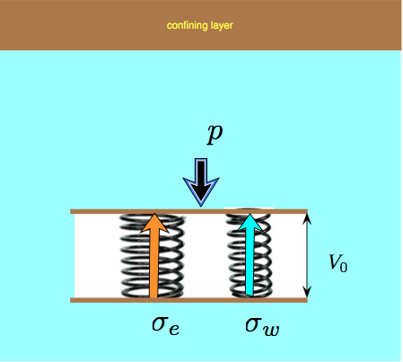
Explaining elastic storage/compression conceptually using two springs (one water, one porous matrix)

Slide 28
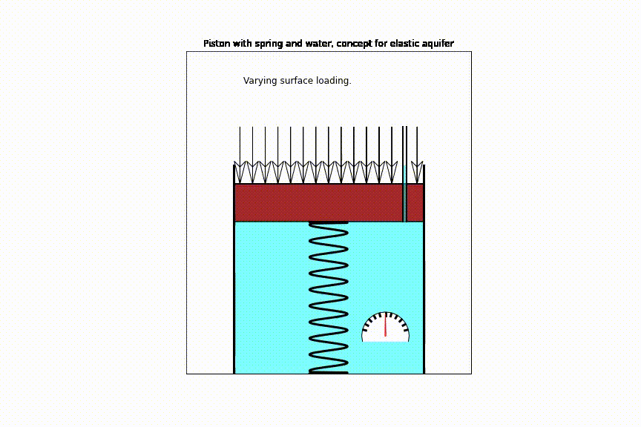

Slide 29
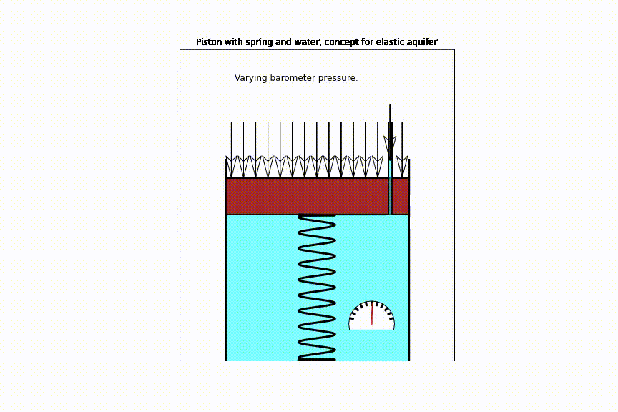

Slide 30
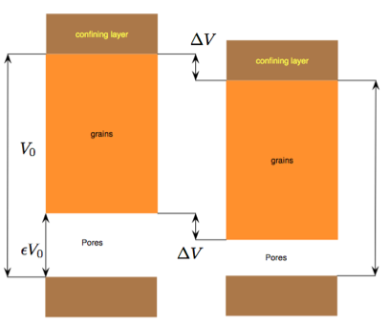
Conceptually split the pore volume from the pure grain volume (virtually uncompressible) and see why the change of aquifer volume equals the change of pore volume.

Slide 31
Pressure changes in and on the ground
Change in overburden (at ground surface)
Loading
Tides (below ocean floor, near coast)
Change in atmospheric pressure
Note: These pressure changes only affect heads in (semi)confined aquifers !

Slide 32
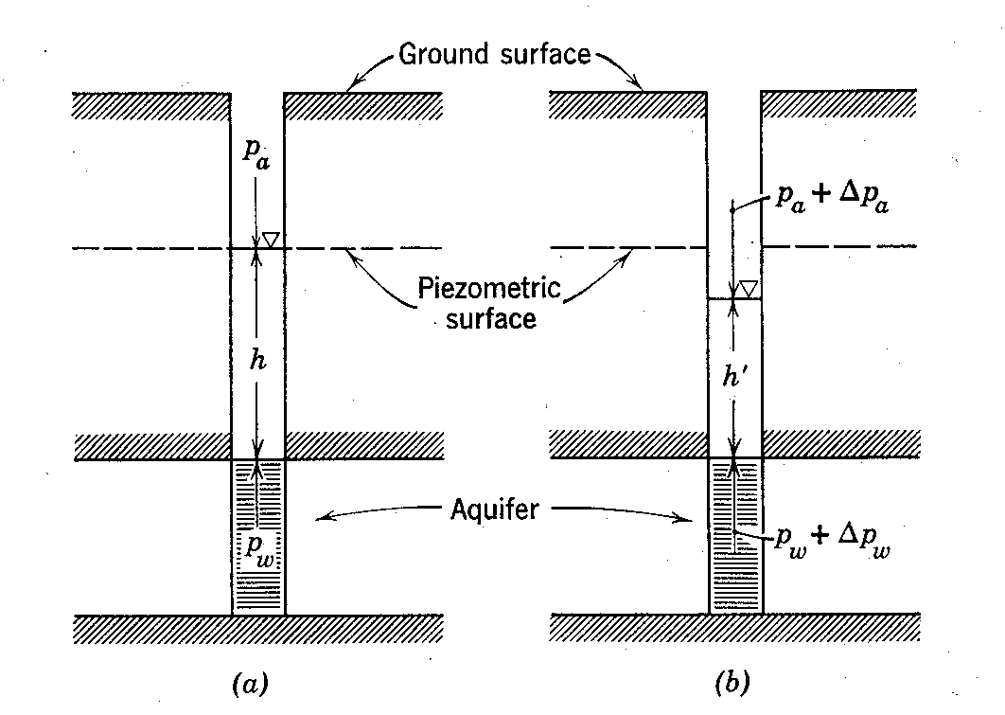
How does the barometer affect head? What’s the difference with loading at ground surface?

Slide 33
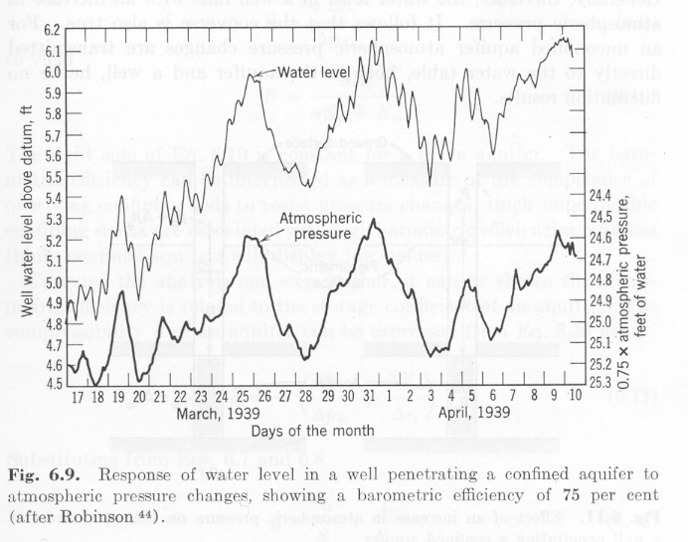
First-ever registration of barometer effect. Notice that the atmospheric axis has been reversed!

Slide 34
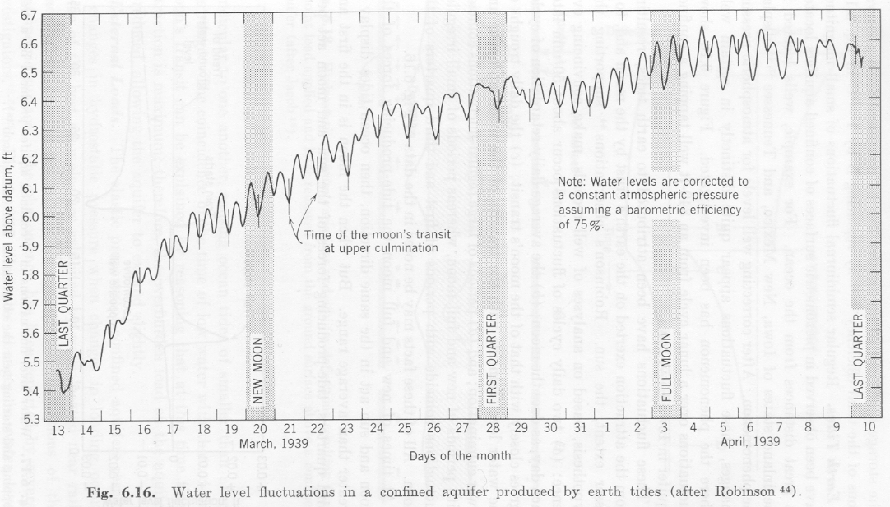
First-ever registered earth tides

Slide 35
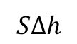
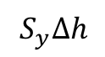
Difference in amount of water drained from a phreatic and and a confined aquifer for the same drawdown
Phreatic aquifer
Confined aquifer
Initial water table
Initial head
Final water table
Drawdown
Final head
impervious
impervious
$$S_{y}Δh$$
Amount drained
$$SΔh$$

Slide 36
Derivation of basic partial differential equation

Slide 37
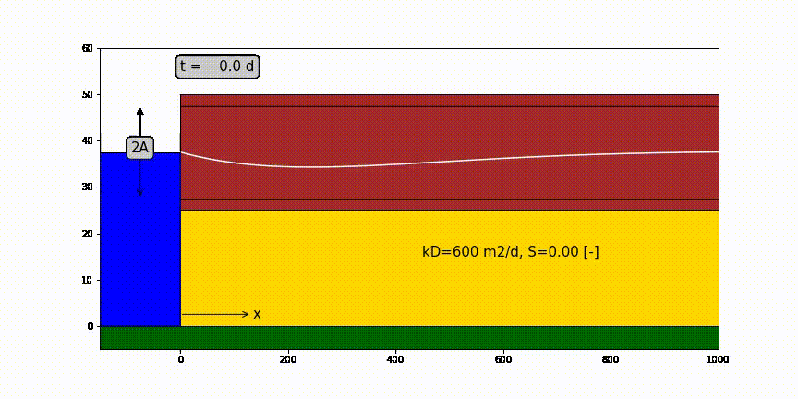
One-dimensional half infinite confined aquifer bounded by surface water at x=0 in which water level fluctuation like a sine.

Slide 38
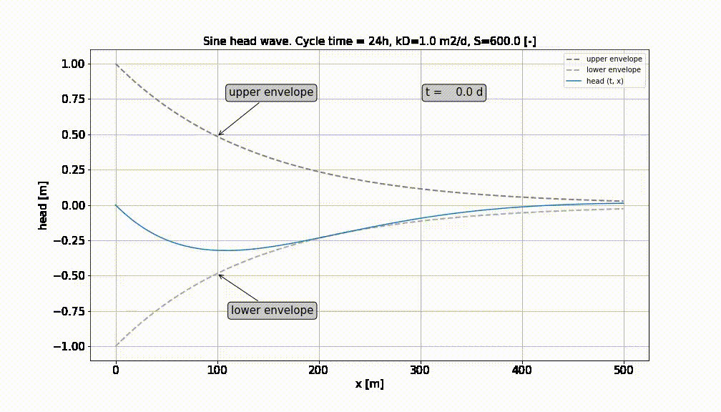

Slide 39
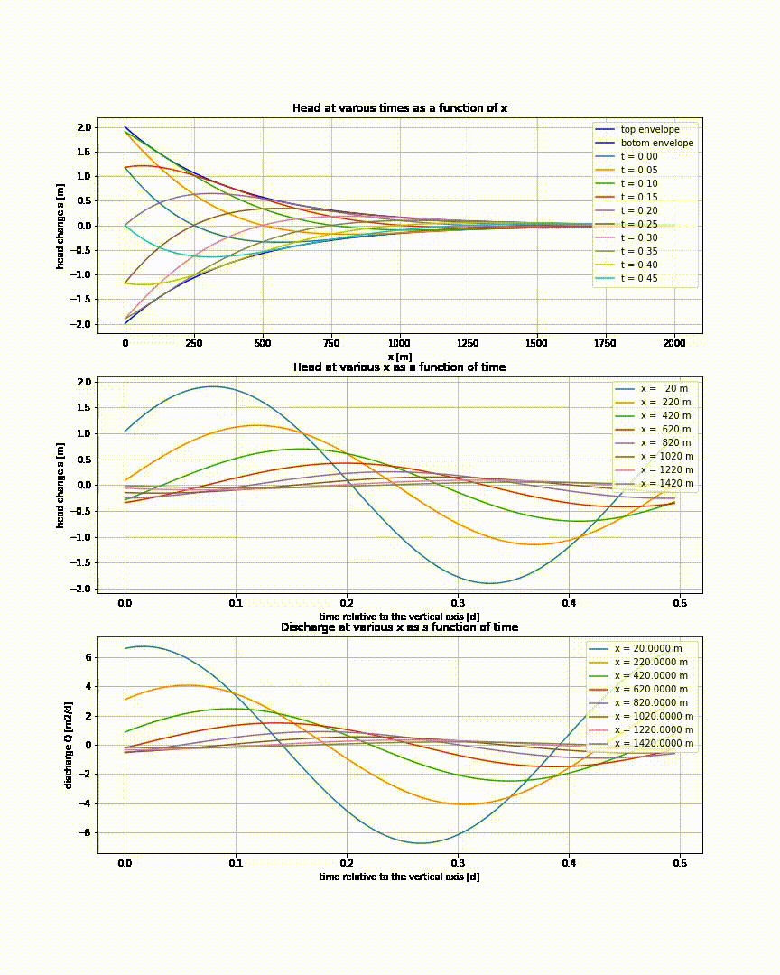

Slide 40
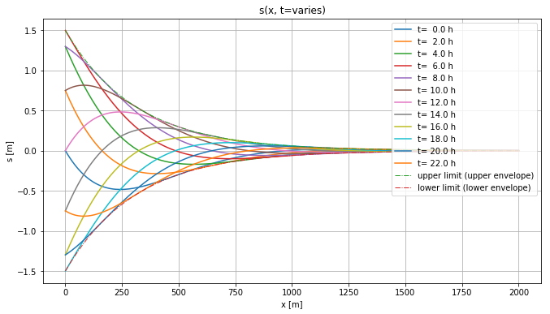
Head in aquifer at different times. Stays within envelopes

Slide 41
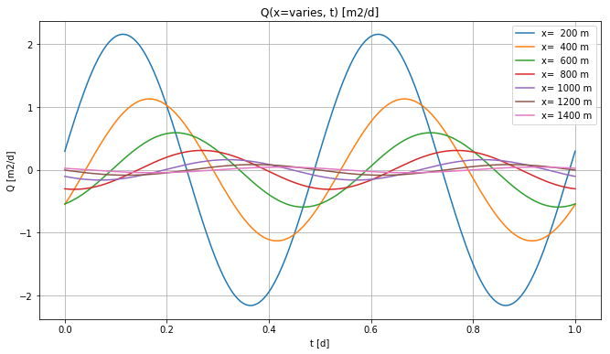
Heads at different x

Slide 42
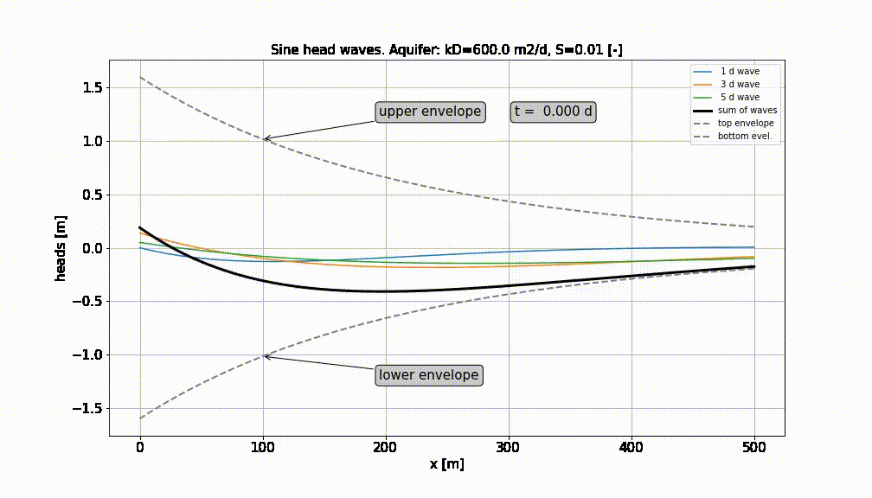
Superpostion of a number of sine-waves

Slide 43
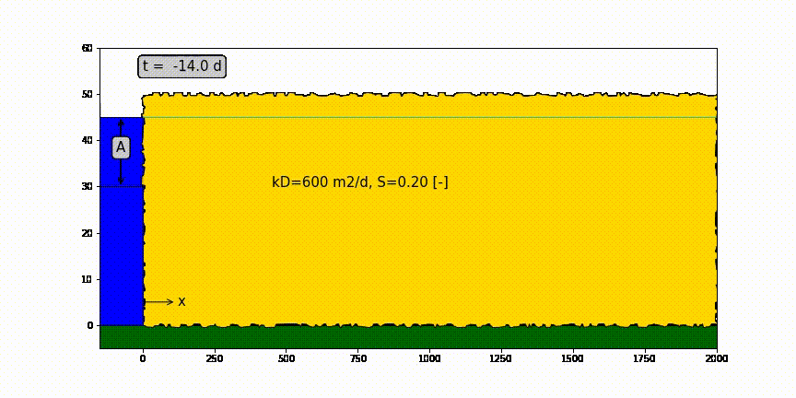
Head change due to sudden head change at x=0

Slide 44
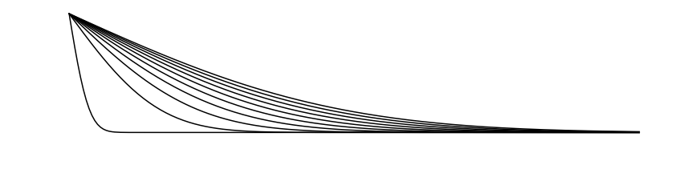
Head change due to sudden head change at x=0
h(x,0)
Drawdown progression
Water table h(x, t) declines with time (= drawdown)
h(x,∞)

Slide 45
Confined aquifer of half-infinite extent with sudden head change A [m] at x=0 and t=0
A
kD
S
x

Slide 46
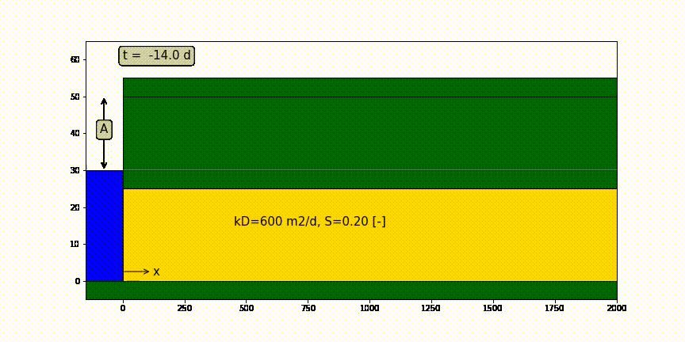
Confined aquifer of half-infinite extent with sudden head change A [m] at x=0 and t=0

Slide 47
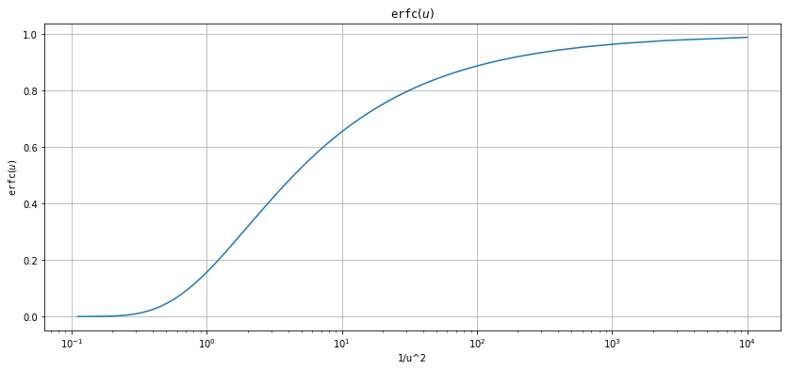
erfc(u) as function of 1/u

Slide 48
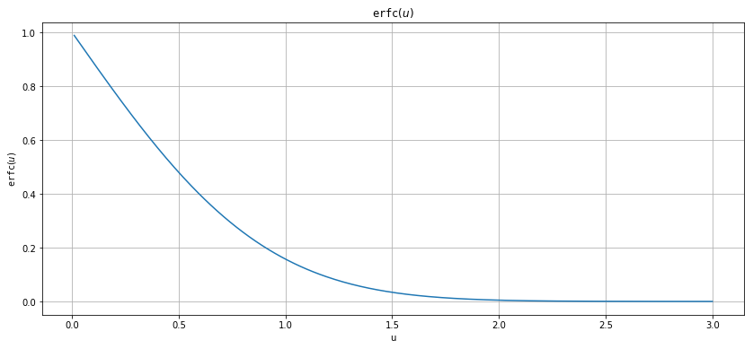
erfc(u) as a function of u

Slide 49
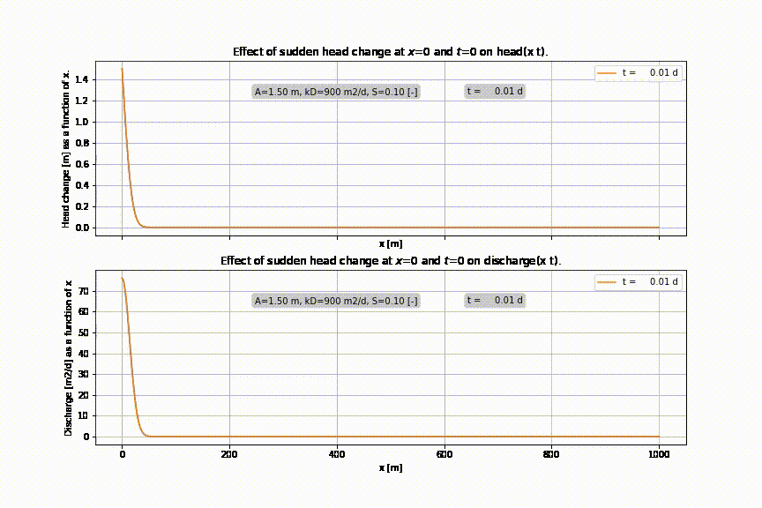

Slide 50
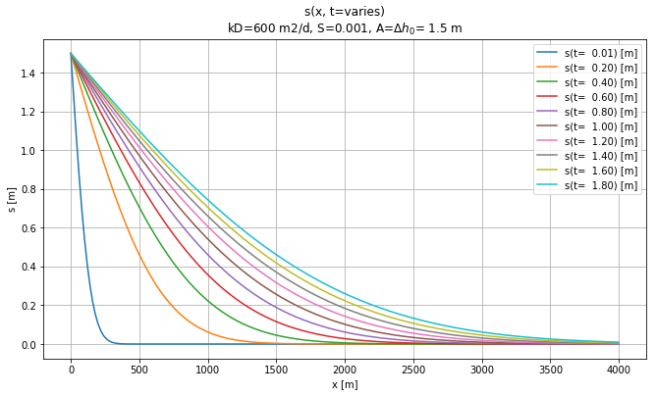
Effect of sudden rise of head at x=0 and t=0

Slide 51
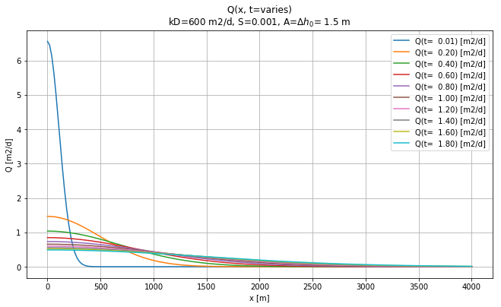
Discharge at different time due to sudden head change at x=0

Slide 52
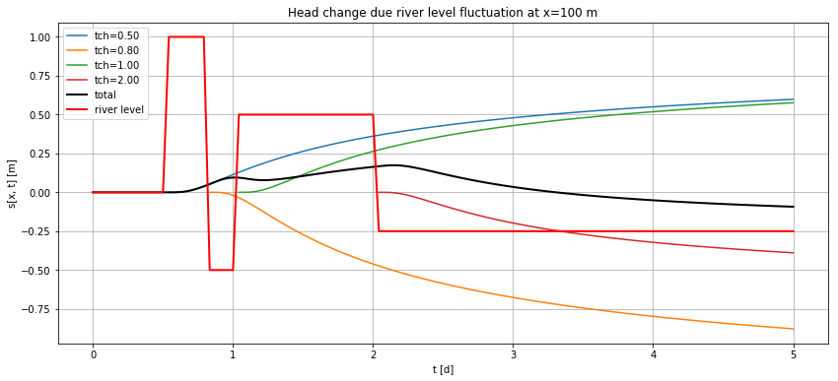
Varying water level at x=0 → do superposition in time

Slide 53
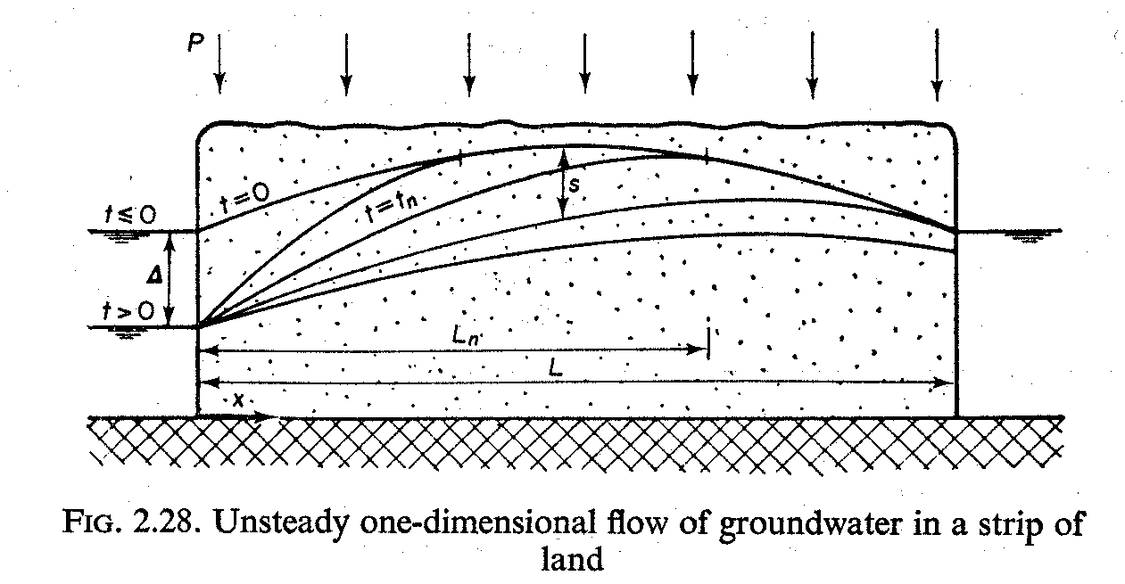
Aquifer is bounded between two fixed-head boundaries, what to do?

Slide 54
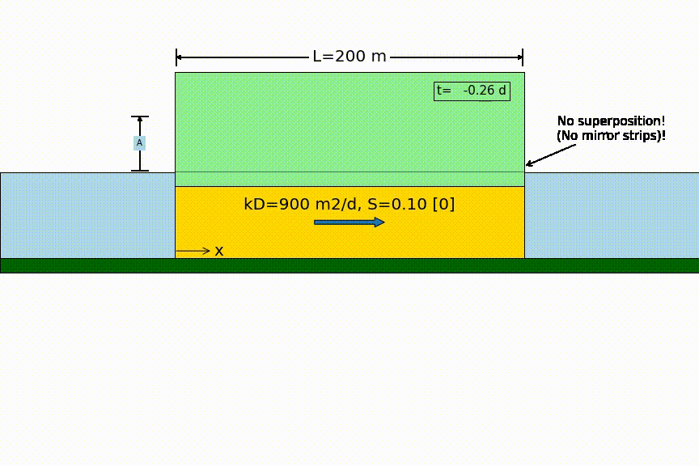
Head changes suddenly on one side

Slide 55
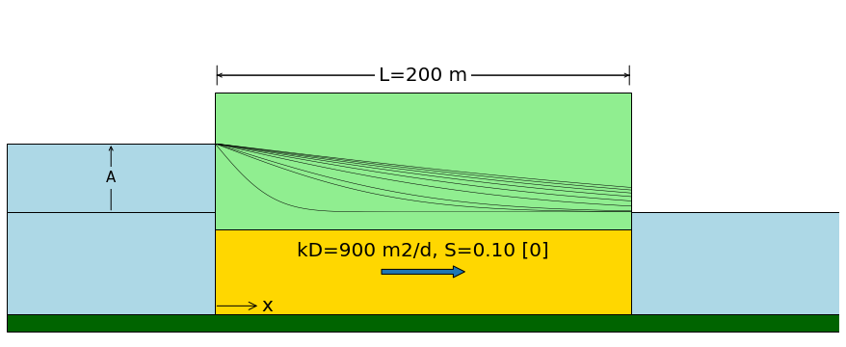
Head changes suddenly on one side
Sudden water level change by A
no longer zero !

Slide 56
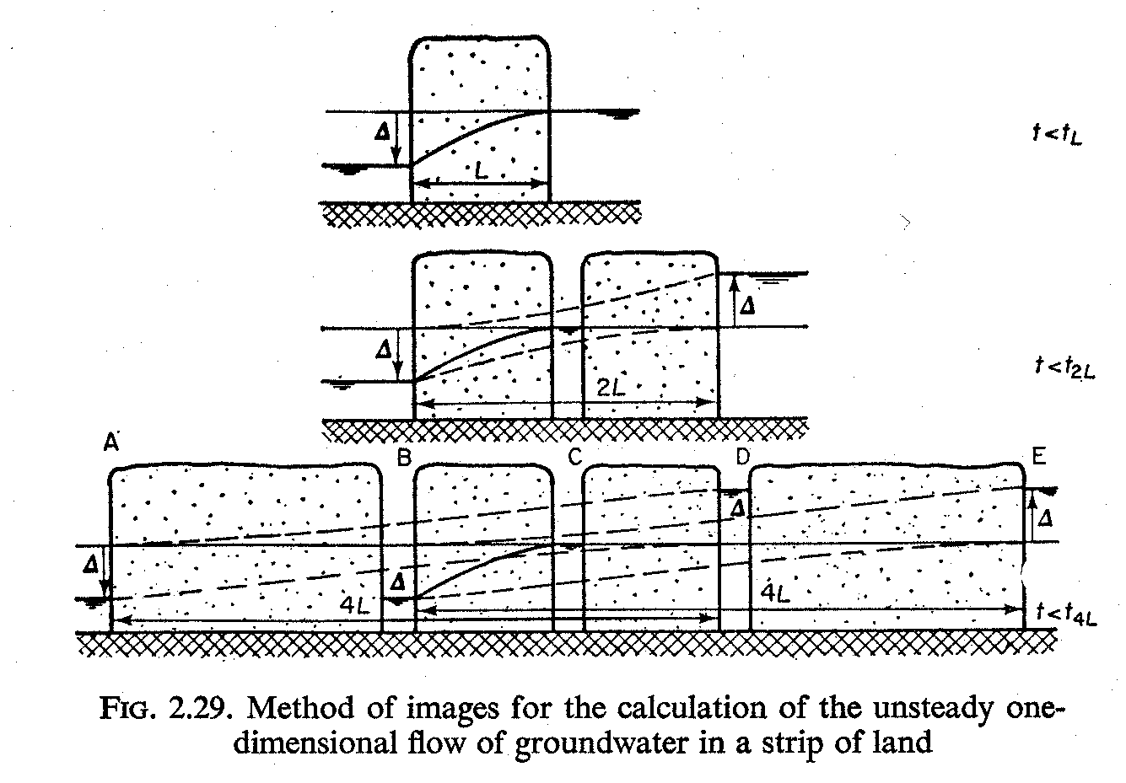
Aquifer is bounded between two fixed-head boundaries→ superposition in space

Slide 57
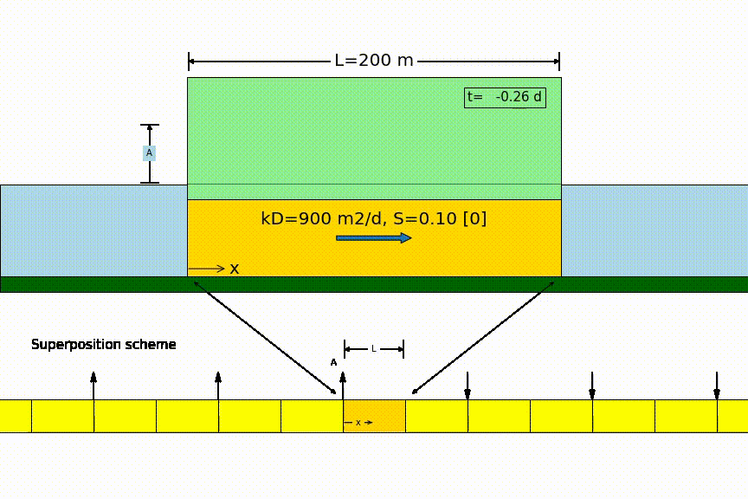
Head changes suddenly on one side

Slide 58
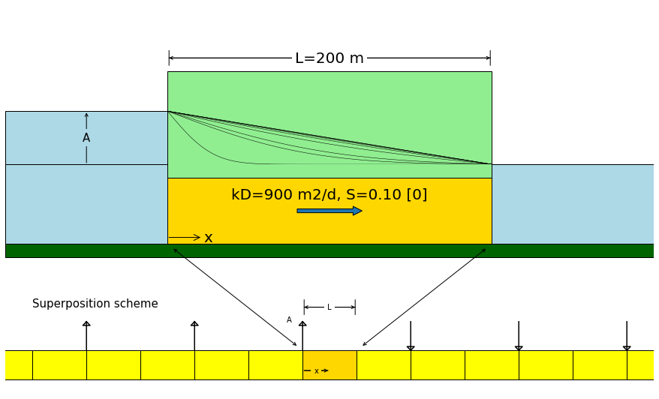
Head changes suddenly on one side
zero

Slide 59
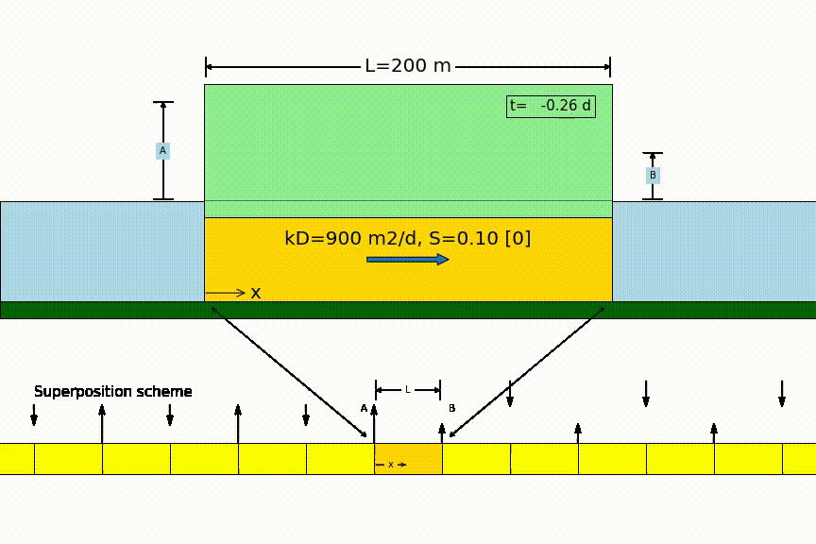
Head changes suddenly on two sides

Slide 60
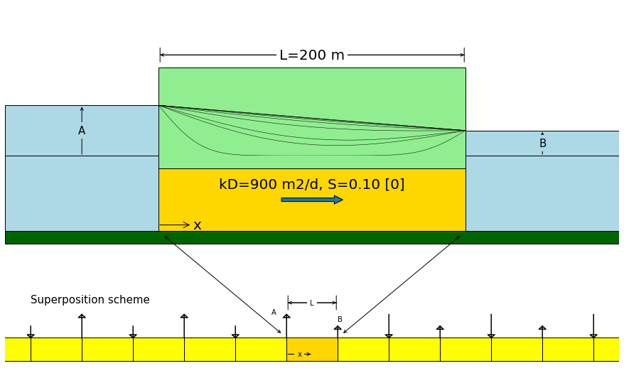
Head changes suddenly on both sides

Slide 61
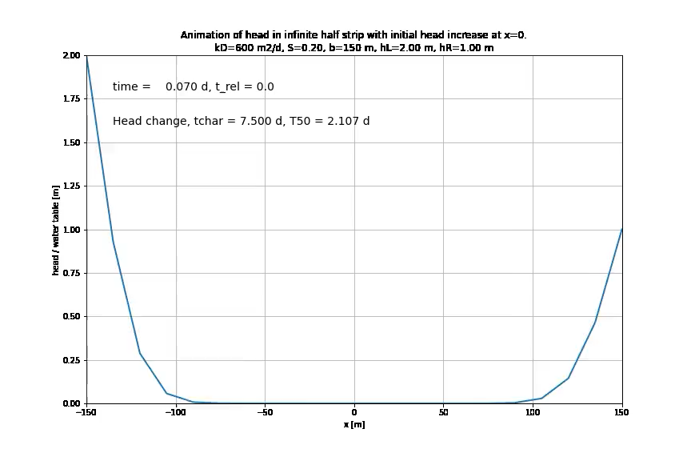

Slide 62


Head changes suddenly on both sides

Slide 63

Symmetrical same sudden head change on both sides

Slide 64

Strip drainage after sudden recharge

Slide 65


Basin drainage (two methods)

Slide 66


Slide 67


Individual terms of power series solution

Slide 68
How fast or slow is the groundwater system ??

Slide 69
desert
qanat
Mountains
Village with crop fields
qanat
qanat
drainage
area
New development
qanat
Cross section along AA’
Village with
crop fields
qanat
Water-table aquifer
Water table
Bedrock

Slide 70

Example groundwater fluctuation depending on distance to boundary

Slide 71


Slide 72



Slide 73


Slide 74

Precipitation – evapotranspiration (daily figures)

Slide 75
Convolution superposition in the time domain

Slide 76


Slide 77


Slide 78


Slide 79


Slide 80


Slide 81
Examples
Groundwater next to a natural river with fluctuation water level
Head due to time-varying Theis well
Head in a groundwater basin driven by varying recharge

Slide 82


Groundwater next to river
Block responses (d𝜏 = 10 min)
Varying river level with groundwater responses
at different distances from the river

Slide 83


Theis well with varying Q
Time-varying well extraction
Block-responses (d𝜏=1 d), at different distances

Slide 84


Result of Theis well with varying Q, compare with Theis well with average Q
Drawdown on linear time-axis
Drawdown on logarithmic time-axis

Slide 85


Groundwater head in land between rivers under varying recharge
Daily recharge figures
Response in 400 m wide basin

Slide 86


Response in 1500 m wide basin
Response in 4000 m wide basin

Slide 87



Block responses d𝜏 = 1d
Basin is 400 m wide
Basin is 1500 m wide
Basin is 4000 m wide

Slide 88
Groundwater flow solutions are often step responses
See the two examples we had before:
Sudden change of river level
Sudden start of pumping a well

Slide 89
Step response
Head,
Concentration,
Temperature
or whatever
t

Slide 90
Transient flow to wells

Slide 91


Slide 94
well
Building pit

Slide 95
Q
s
c
kH
S
r

Slide 96
Q
s
S_{y}
h
k
r

Slide 97


Slide 98


Slide 99

Match point

Slide 100

Match point

Slide 101
Match point

Slide 102



Slide 103


Slide 104


Slide 105
Hantush (1956)
Transient radial symmetric flow towards a well
in a semi-confined aquifer
Q
φ
s=φ-φ_{o}
φ_{o}
c
kD
λ²=kDc

Slide 106
Measuring from above
Measuring from below
b
a
z
D
a
r
r
b
z

Slide 107
r_{c}
k
r_{w}
h
r

Slide 108
Key questions
Can you derive the elastic storage coefficient of aquifers?
Same for barometric efficiency?
Same for effect of overburden change?
How do barometric efficiency and overburden efficiency relate to each other?
How can specific storage coefficient be derived from measured barometric efficiency?
How does specific storage relate to elastic storage of an aquifer?
Have any idea of values of specific storage found in practice?
Same for specific yield of sand?
What is the dimension of specific yield S_{y}, specific storage S_{s} and elastic storage S?
Which of the two is largest (specific yield or elastic storage, and how much larger?)
For the cracks: could you derive the effect of earth tide on groundwater head?

